Slide 1
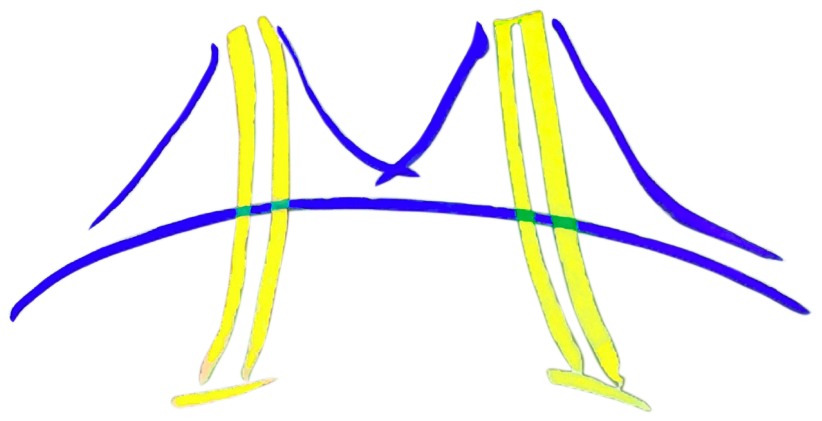


Productive Design of Extensible On-Chip Memory Hierarchies
Henry Cook
5/10/2016
Dave Patterson, Krste Asanović

Slide 2
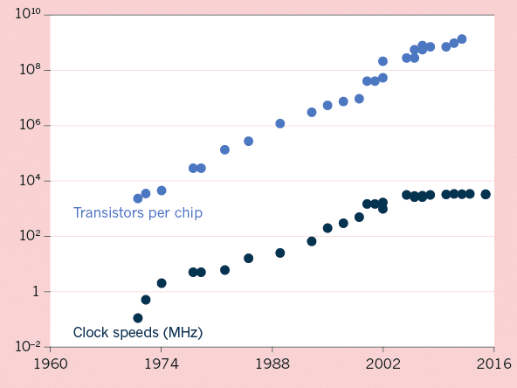
The end of Moore’s Law?
Dennard Scaling
Tick/Tock broken
Parallelism
Specialization
Design renaissance

Slide 3
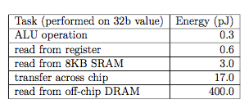
Where’s the energy going?
Caching/Hierarchy
Table of J/ops

Slide 4
Who’s in charge?
of managing the memory hierarchy

Slide 5
What is cache coherence?
SWMR
Policy vs Protocol

Slide 6
Why is cache coherence hard?
Distributed consensus about which agent has what permissions on a cache block
Permissions changes need to be done correctly and atomically
Concurrency must be managed in high BW systems
Semantic gap between verifiable specification and concrete implementations

Slide 7
What can be done?
Language and Tools
Meta-programming
Functional programming
Objects & multiple inheritance
Development Methodology
Design space exploration
Generators >> design instances
Agile & open source

Slide 8
What does this thesis contribute?
A general framework for context-dependent parameterization of hardware generators.
A set of Chisel libraries for generating extensible cache-coherent memory hierarchies.
A methodology for decomposing high-level descriptions of cache coherence protocols into controller-localized, object-oriented transactions.

Slide 9
Design Ethos
Productivity
“The essence of abstractions is preserving information that is relevant in a given context, and forgetting information that is irrelevant in that context.”
Guttag
Extensibility
“A successful platform means that building the second thing is easier than building the first.”
Katz

Slide 10
Three Interacting Abstractions

Slide 11
Chapter 3: TileLink

Slide 12
What is TileLink?
A framework designed to be a substrate for policy transactions
Hierarchical / composable / deadlock-free
Built-in message types (for accelerators)
Extensible with custom message types (for CC)

Slide 13
Transactional view of cache coherence

Slide 14
Channels
Acquire
Initiates a transaction to acquire access to a cache block with the proper permissions.
Also used to write data without caching it locally.
Probe
Queries a client to revoke its permissions on a block.
Release
Acknowledges probe receipt, releasing permissions on the block.
Also used to voluntarily write back dirty data.
Grant
Provides data or permissions to the original requestor, granting access to the cache block.
Also used to acknowledge voluntary Releases.
Finish
Final acknowledgment of transaction completion from requestor.

Slide 15
Assumptions and guarantees
Relative channel priorities -> forward progress
Finish messages -> unordered p2p delivery

Slide 16
Manager-Client Pairing (MCP)

Slide 17
Supply concrete physical networks

Slide 18
Chapter 4: CoherencePolicy

Slide 19
Object orientation in hardware
Objects are abstractions that contain fields of data that are mutated and accessed by procedural methods
opaque blobs of bits
Encapsulation
Controller authors don’t need to know the specific format used or the meaning of individual bits
Policy authors get a set of questions to answer

Slide 20
Client Metadata
Metadata contains client state, policy determines:
what permissions apply to each state
which messages to send in response to mem ops or Probes
how to change state in response to ops, Probes, Grants
A sample of ClientMetadata’s API:
isValid()
isHit(cmd)
makePrimaryAcquire(id, addr, cmd)
makeVoluntaryWriteback(id, addr, data)
makeRelease(probe, id, data)
onHit(cmd)
onProbe(probe)
onGrant(incoming, outstanding)

Slide 21
ManagerMetadata
Metadata contains manager state and/or sharer tracking information, policy determines:
what permissions apply to each state
which messages to send in response to Acquires or Releases
how to change state and sharers in response to Releases and Grants
A sample of ManagerMetadata’s API:
requiresProbes(acquire)
makeProbe(acquire)
makeProbeForVoluntaryWriteback()
makeGrant(acquire, id, data)
onRelease(incoming, source_id)

Slide 22
HierarchicalMetadata
A single agent can be both a Manager with respect to inner caches and a Client with respect to some outer cache or hub
Has both types of metadata
Uses memory op codes to translate Acquires, Releases and Probes between realms

Slide 23
Supply concrete directory format

Slide 24
Chapter 4: Message Flows

Slide 25
Message flows
Global view of transaction
Used to generate invariants for formal methods

Slide 26
A writeback flow

Slide 27
A load miss sub-flow

Slide 28
A store flow

Slide 29
Fun!

Slide 30
From global to local flows

Slide 31
From local flows to cache controllers
Sub-flows expressed as Scala traits containing
methods on ports
scoreboard bits tracking dataflow
Transaction Handling Status Registers (TSHRs)
combine traits with required functionality
express any inter-sub-flow dependencies

Slide 32
Supply concrete agent resources

Slide 33
Separation of concerns
Notes:
A metadata-based policy is not concerned with anything having to do with time or ordering, only with what action needs to be taken when the system is in a particular state. This factoring allows multiple policies to be plugged in without changing controller design or network implementation.
The TileLink framework determines what types of messages any coherence policy methods can possibly output. It is not concerned with which messages should be sent under what conditions, just the relative priority and allowed orderings of the general message types. This factoring allows multiple network implementations to be plugged in without changing controller design or policy contents.
Message flow factoring allows the pipeline implementation of the cache controller logic to be changed without requiring changes to the policy description or network implementation.
Agent implementations use both other abstractions to simplify their code density and increase code reuse, and
both abstractions provide structure to the high-level, global message flows that can be productively verified.

Slide 34
What? (field widths and return types)
Notes:
By separating information about timing from policy decisions, policy designers only have to consider
current state and desired operation, yet know what general type of message needs be produced.
By eliding information about policy from the networking substrate, NoC designers know what priority channels to provision
to support any compatible policy.

Slide 35
When? (possible and actual orderings)
Notes:
TileLink transactions limit the shape of possible messages flows by declaring which ones are safe to compose.
Message flows serve as the glue that link TileLink sub-flows together based on info from local storage

Slide 36
Which? (differentiation)

Slide 37
All for one and one for all
Notes:
Message flows choose

Slide 38
Rocket Chip SoC generator
Open source
Available on github
700 commits
26 contributors
64 forks
K. Asanović, et al. The Rocket Chip Generator. Technical Report UCB/EECS-2016-17, EECS Department, UC Berkeley, Apr 2016.
Notes:
open source, on github
external collaborators
forks

Slide 39
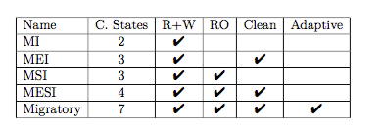
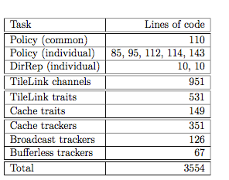
Rocket Chip protocol implementations
5 policies
2 directory representations
3 manager implementations
7+ client implementations
2 NoC implementations

Slide 40
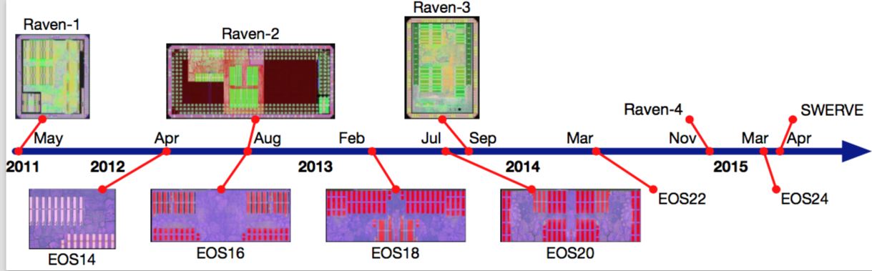
We built some chips!
Y. Lee, et al. A 45nm 1.3ghz 16.7 Double-precision gFLOPs/W RSIC-V Processor with Vector Accelerators.
In ESSCIRC 2014-40th, pages 199–202. IEEE, 2014.
Y. Lee, et al. An Agile Approach to Building RISC-V Microprocessors.
In IEEE Micro, 35, 2015.
B. Zimmer, et al. A RISC-V Vector Processor with Tightly-Integrated Switched-Capacitor DC-DC Converters in 28nm FDSOI.
In Symposium on VLSI Circuits 2015, pages C316–C317. IEEE, 2015.
C. Sun, et al. Single-chip Microprocessor that Communicates Directly Using Light.
In Nature, 528:534–538, 2015.
Notes:
Three distinct lineages (each incorporating novel device technology)
All from same source code base
All using memory hierarchy generator
From single core + htif, to multicore, to core + accel, plus L2 cache

Slide 41
Future directions (for research)
Design space exploration using generators
Automate building parameterized models
Constrained and intelligent search
Formal verification and high-level specs
Automated generation of directed tests
Automated generation of new implementations
Application-specific protocols
Energy consumption is the key metric
Software memory management architecture

Slide 42

Future directions (for me)
Notes:
By bringing the power of open-source and agile hardware design to the semiconductor industry,
SiFive reduces the cost to harness the performance and energy-efficiency of customized silicon,
enabling whole new ranges of applications.

Slide 43
Bonus storytime

Slide 44

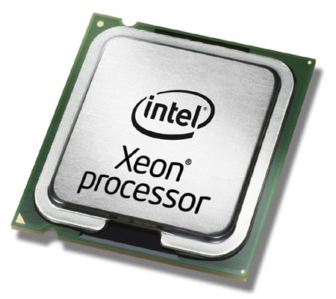
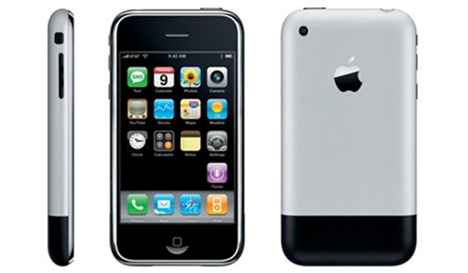

Bonus storytime
ASP-GMM
CudaDMA
2007
VLS
RAMPGold
SnbQoS

Slide 45
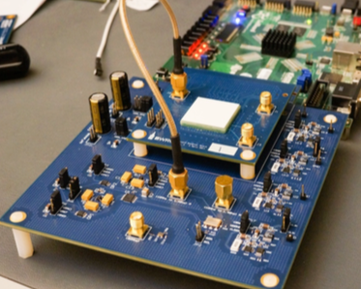
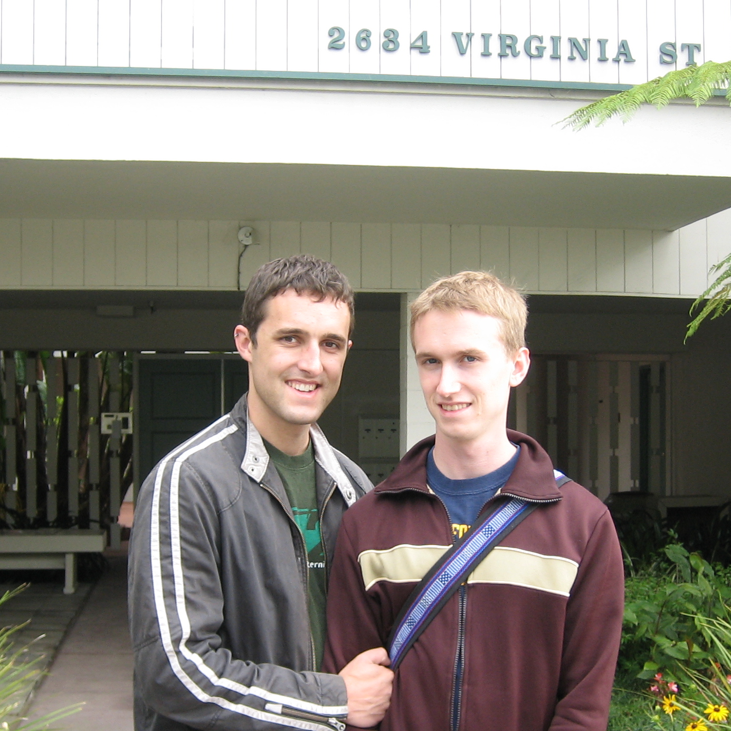



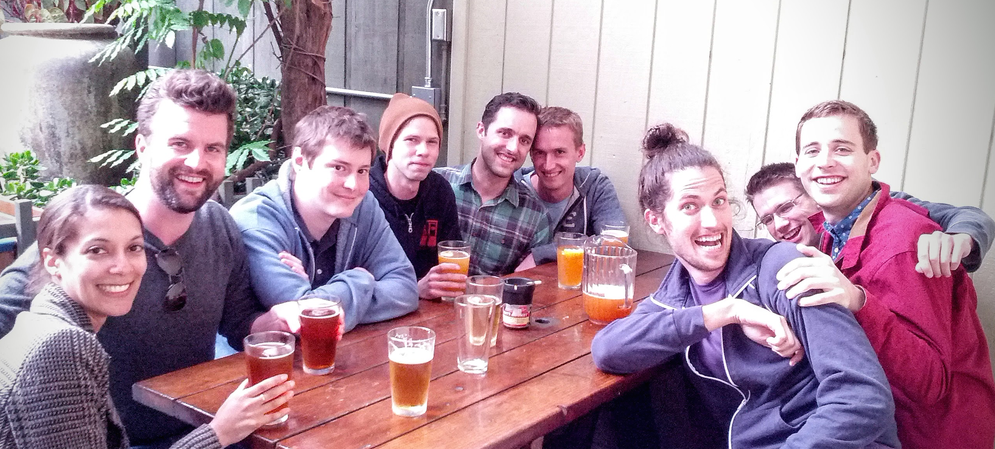






How to graduate quickly
Focus on LPUs
don’t build hardware
Stay single and friendless
relationships are a distraction
Don’t piggyback travel
don’t invite coworkers
Don’t get out
Don’t come out
Time travel to graduation

Slide 46

Acknowledgments
Krste & Dave
+ Armando, Jonathan & Brucek
Collaborators & Barchitects
Friends & Family
Michael
Sponsors, particularly:

Slide 47
Agile Hardware Development
Y. Lee, A. Waterman, H. Cook, B. Zimmer, A. Puggelli, J. Kwak, R. Jevtic, B. Keller, S. Bailey,
M. Blagojevic, P.-F. Chiu, R. Avizienis, B. Richards, J. Bachrach, E. Alon, B. Nikolic, and K. Asanovic.
An agile approach to building risc-v microprocessors. IEEE Micro, 35, 2015.

Slide 48
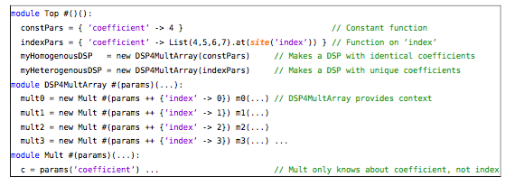
Context-Dependent Environments

Slide 49
CDEs: hierarchy modifications

Slide 50
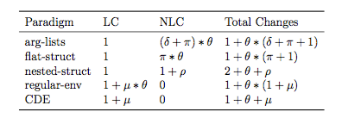
CDEs: provably robust
We can estimate the number of source code changes that will propagate through a module hierarchy given θ new parameters added

Slide 51
Parameterizing Agents with CDEs

Slide 52
DirectoryRepresentation API
pop(id: UInt): Remove id from the prior set of sharers.
push(id: UInt): Add id to the set of sharers.
flush(): Provide an empty set that indicates no sharers.
none(): True if there are no shared copies among this manager’s clients.
one(): True if there is a single copy at a client.
count(): Total count of the sharers among clients.
next(): Provide the id of the client that should be Probed next.
full(): Provide a full bitmap of all sharers, where a 1 indicates a copy.

